Slide 1
NDU Research and the
NDU Scholars Program
AY 2022-2023
Dr. Laura J. Pulzone
Director
Institute for National Strategic Studies (INSS)

Slide 2
Institute for National Strategic Studies (INSS)
INSS mission is to:
Conduct research in support of the academic programs at NDU
Provide strategic support to the Secretary of Defense, the Chairman of the Joint Chiefs of Staff, the Services and Combatant Commands
Engage with the broader national security community in the service of the common defense

Slide 3
Organizational Structure
Institute for National Strategic Studies (INSS)
President
National Defense University
Provost
National Defense University
Director of
Institute for National Strategic Studies (INSS)
NDU Scholar Board
Research Council
NDU Sabbatical Board
Center for Strategic Research
Center for the Study of Chinese Military Affairs
Center for the Study of Weapons of Mass Destruction
National Defense University Press

Slide 4
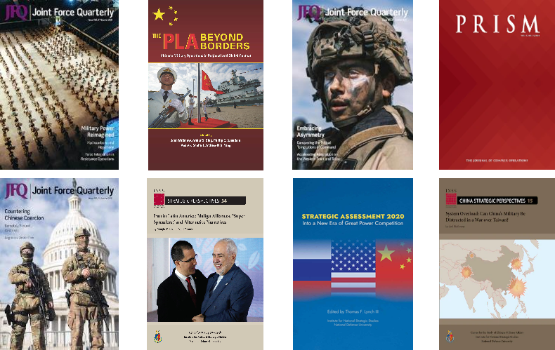
Publishing at NDU

Slide 5
NDU Scholars Program
(NSP)

Slide 6
NDU Scholar Program
Selective and challenging program for students​
  A rigorous academic program that enhances outcomes-based student learning and professional development.
  Enables students to write a research paper on an issue of strategic importance for Department of Defense and US government stakeholders​.
Topics address real-world policy issues at ​
  Most combatant commands​.
  The Office of the Chairman of the Joint Chiefs of Staff​.
  State Department​.
  Department of Homeland Security​.
Additional information will be available on Blackboard

Slide 7
Why Participate in NDU Scholar Program?
Qualifying students receive:
  Experience addressing real-world topics​.
  Opportunity to research a topic deeply and produce a paper that will help the CJCS, JS, CCMD.
  Additional research support​.
  Opportunity to outbrief senior leaders (J-Dir, Dep CCMD) on your findings.
  Opportunity to publish and disseminate their research to a wider DoD/lnteragency audience.
  Opportunity to be noticed by CJCS, JS, CCMD, which may assist with your post-NDU assignment.

Slide 8
What is the application process?
Pick a topic and discuss with the stakeholder liaison.
Contact your college faculty advisor; scope out topic/approach.
Submit application to your college faculty advisor by 26 August. Applications must include:
  Written proposal based on NDU Scholars Program criteria. Template with thesis statement/question, methodology, and literature review
  Name and signature of college faculty advisor
  Approval from College Dean of Faculty
4. Brief proposal to NSP Board - 12-16 September.

Slide 9
Review of NDU Scholars Contact List
All NSP information is on Blackboard
College Faculty Advisors
  ES (James Van de Velde) james.r.vandevelde.civ@ndu.edu
  JFSC (Mary Bell) mary.s.bell.civ@ndu.edu
  NWC (Mark Bucknam) mark.bucknam@ndu.edu
  CIC (Jim Churbuck) ChurbuckJ@ndu.edu
  CISA (Laurinda Reifsteck) l.m.reifsteck.mil@ndu.edu

Slide 10
QUESTIONS?

